Slide 1

The Arizona STEM Acceleration Project
Catapult

Slide 2

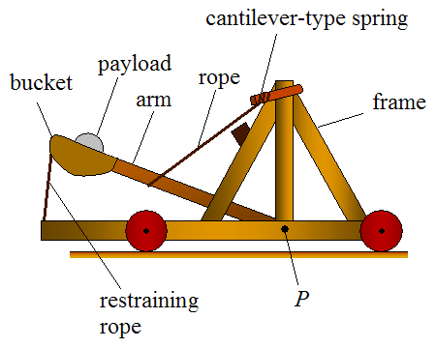
Catapult
A [6-8] grade STEM lesson
Savita Narang
06/19/2023

Slide 3
Notes for teachers
List of Materials
popsicle sticks or any wooden pieces of suitable size
rubber bands
a plastic or wooden spoon
a ping pong ball or any other small and safe object
a target
measuring tape
This lesson takes a total of two hours to complete.
Students may work in groups of 2-4.
An emphasis on the target product( The catapult should be able to launch a small object to a desirable distance.)
Creative and innovative designs should be encouraged.)
Students should be given some information on the history of catapults.
Notes:
Notes and Materials: My MESA club students made different kinds of catapults in different years. The launch materials were golf ball, eggs, bean bags in different years. The targets were a receptacle or a cornhole board. The receptacle for the egg launch was supposed to be cushioned with something so that the egg does not break.

Slide 4
Standards
Standards
6.P2U1.4 Develop and use a model to predict how forces act on objects at a distance.
6.P4U2.5 Analyze how humans use technology to store (potential) and/or use (kinetic) energy.
7.P2U1.2 Develop and use a model to predict how forces act on objects at a distance.
8.P4U2.5 Develop a solution to increase efficiency when transferring energy from one source to another
Science and Engineering Practices
● Ask questions that arise from careful observation of phenomena, models, or unexpected results. ● Ask questions to clarify or identify evidence and the premise(s) of an argument. ● Ask questions to determine relationships between independent and dependent variables. ● Ask questions that challenge the interpretation of a data set. ● Ask questions to clarify and refine a model, an explanation, or an engineering problem. ● Define a design problem that can be solved through the development of an object, tool, process or system and includes multiple criteria and constraints, including scientific knowledge that may limit possible solutions. ● Formulate a question that can be investigated within the scope of the classroom, school laboratory, or field with available resources and, when appropriate, frame a hypothesis (a possible explanation that predicts a particular and stable outcome) based on a model or theory.
6.RI.1 Cite textual evidence to support analysis of what the text says explicitly as well as inferences drawn from the text.
6.RI.3 Analyze in detail how a key individual, event, or idea is introduced, illustrated, and developed in a text (e.g., through examples or anecdotes).
8.RI.3 Analyze how a text makes connections among and distinctions between individuals, ideas, or events (e.g., through comparisons, analogies, or categories).

Slide 5
Objective(s):
Today we will learn about the history of catapults.
Today we will learn about the physics of catapults.
Today we will work with our team and complete an engineering design challenge.
Today we will build and test our catapult.

Slide 6
Agenda (110-120 minutes)
The History of Catapults (9 minutes) Discussion 10-15 minutes
Catapult Physics (Reading and Discussion - 30-35 minutes)
Building time - 45 minutes
Testing time - 15 minutes

Slide 7
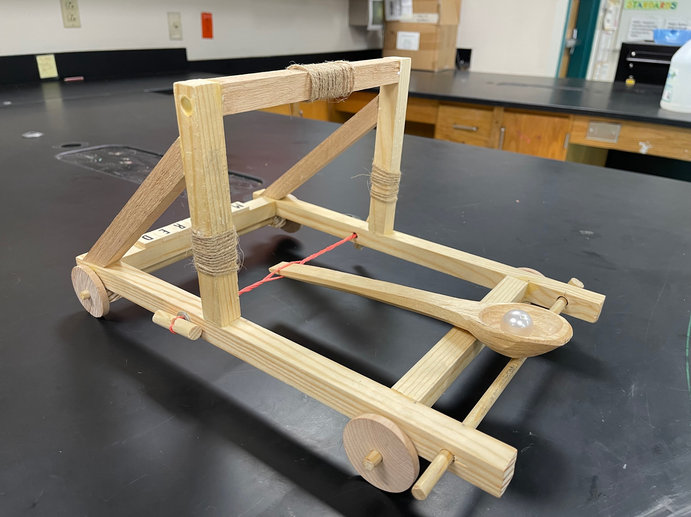
Intro/Driving Question/Opening
What is a catapult?
What is the history behind catapults?
What physical science concepts are used in the building and testing of catapult?

Slide 8
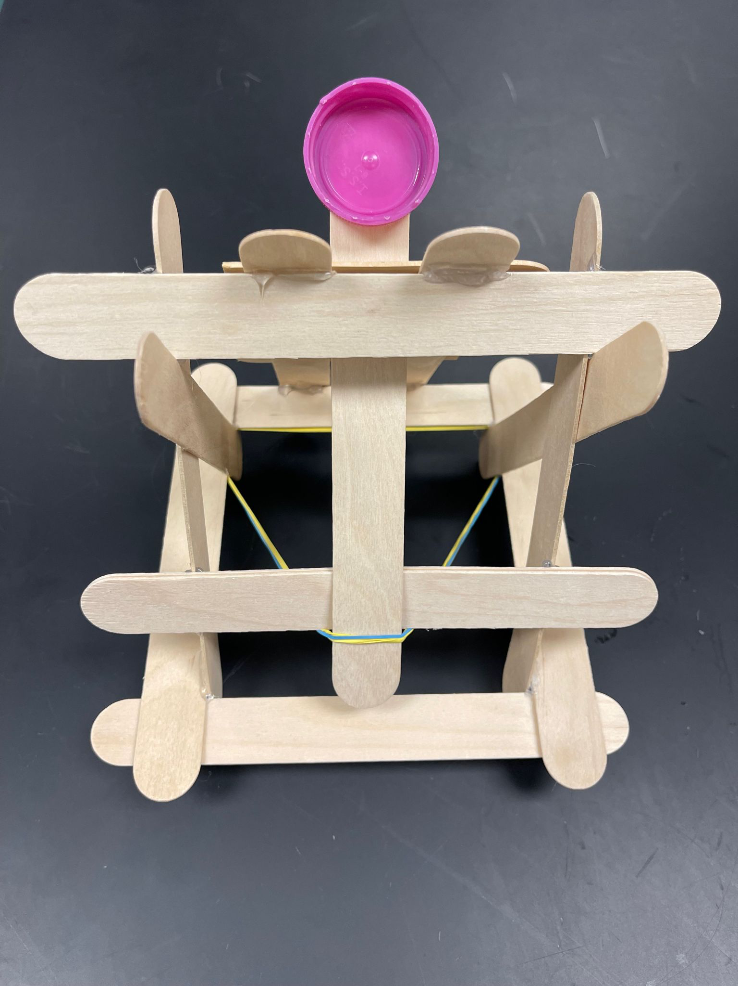
Hands-on Activity Instructions
Constraints
This activity can be done in a group of 2-4 students.
Build a catapult using the materials suggested/provided. The group that is able to launch the ping pong ball/ cotton ball/marble etc. to the farthest distance or to a certain target will be the winner.
Time - Two hours
Safe materials
Angle of release

Slide 9
Assessment
Test your catapult:
Is it able to launch a ping pong ball or any other safe object?
At what angle are you releasing it?
How are you changing potential energy to kinetic energy?
Is it making a projectile motion?
What is the maximum distance that your ping pong travels?

Slide 10
Differentiation
Remediation
Extension/Enrichment
Those who have trouble getting started, show them some pictures, videos, or some previously designed models.
Those who find building difficult, they can be involved by asking them to color the popsicle sticks.
They can also be asked to measure the distance traveled by the ping pong ball.
They can be asked to retrieve the ping pong ball after it is released.
Those who find it too simple, they can be asked to make a bigger version using large wood pieces or PVC pipes.
They can test releasing a golf ball, an egg, or a bean bag on a target or inside a receptacle.
Notes:
Alternative for students who struggle with design: Nat Geo Catapult

